Slide 1
LESSON 15
NEXTJS NFT Marketplace
Garry Abel Diaraja H - 1103190147

Slide 2
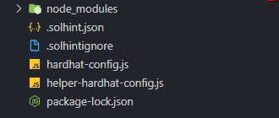
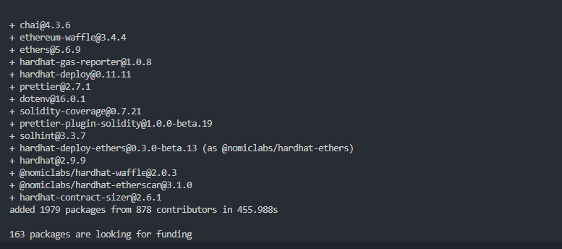
Part I: NFT Marketplace Contracts (Setup)

Slide 3

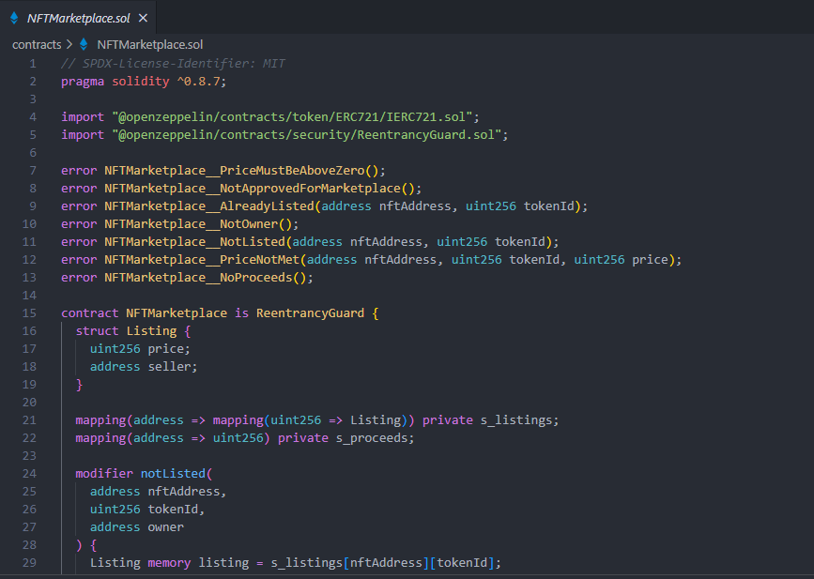
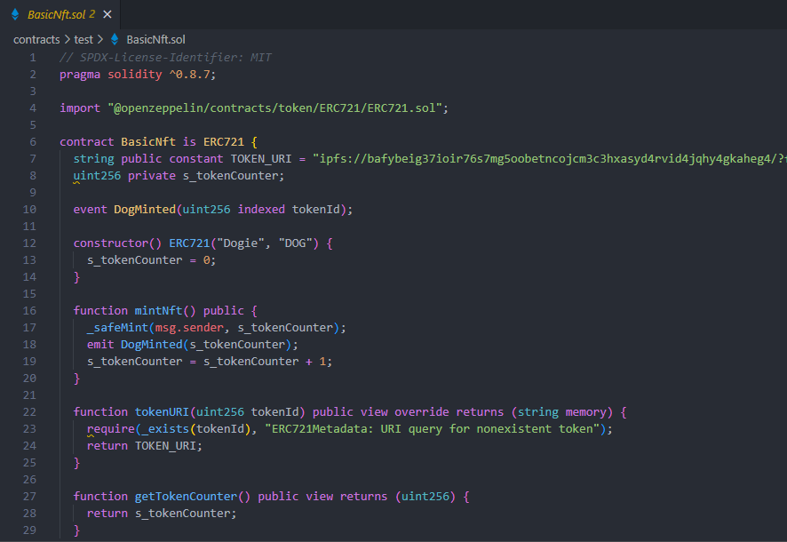
Part I: NFT Marketplace Contracts

Slide 4

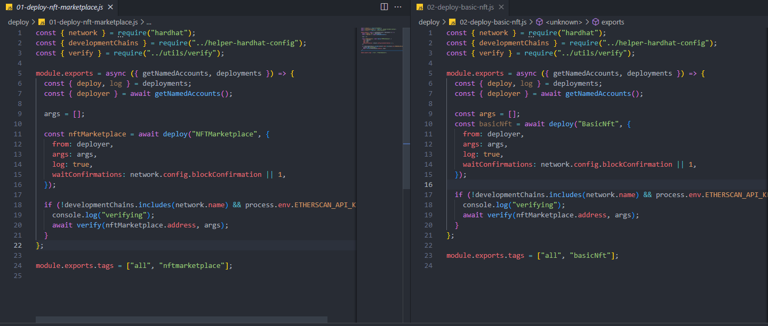
Part I: NFT Marketplace Contracts (deploy)

Slide 5
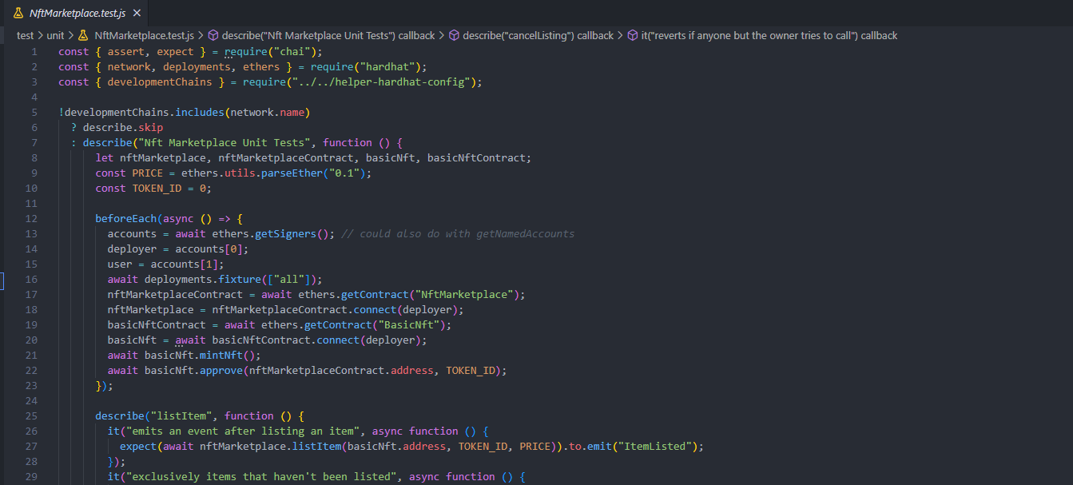
Part I: NFT Marketplace Contracts (unit test)

